Slide 1



Страновой офис ЮНИСЕФ в Казахстане
Навыки для девочек:
Программа по разработке наноспутников

Slide 2

Запусти свою мечту: Образовательная программа по разработке наноспутников UniSat для девочек (UNEPG)
UNEPG является совместным проектом ЮНИСЕФ Казахстан и Казахского национального университета имени аль-Фараби

Slide 3
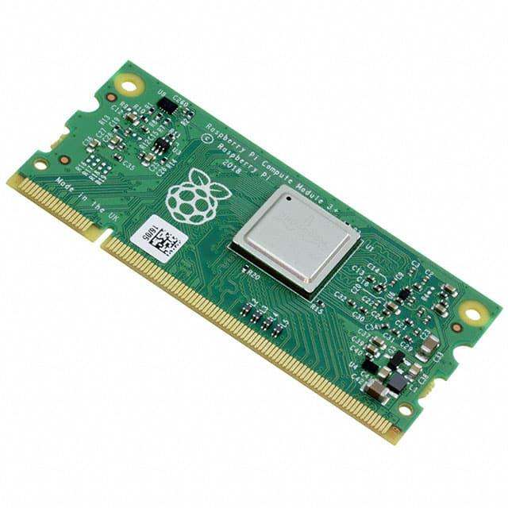


Lecture 1: Quick introduction to the OBC
What is an on-board-computer (OBC)?
What are the main functions of the OBC?
What are the main hardware components of the UniSat OBC?
CREDIT: ISS National Laboratory
kaznu.kz
sciencepark.kz
Notes:
The On-Board Computer (OBC) is the brain of the UniSat. This lesson gives you quick introduction to the OBC of the UniSat nano-satellite. And also we are going to learn the main OBC functions, and hardware components.

Slide 4
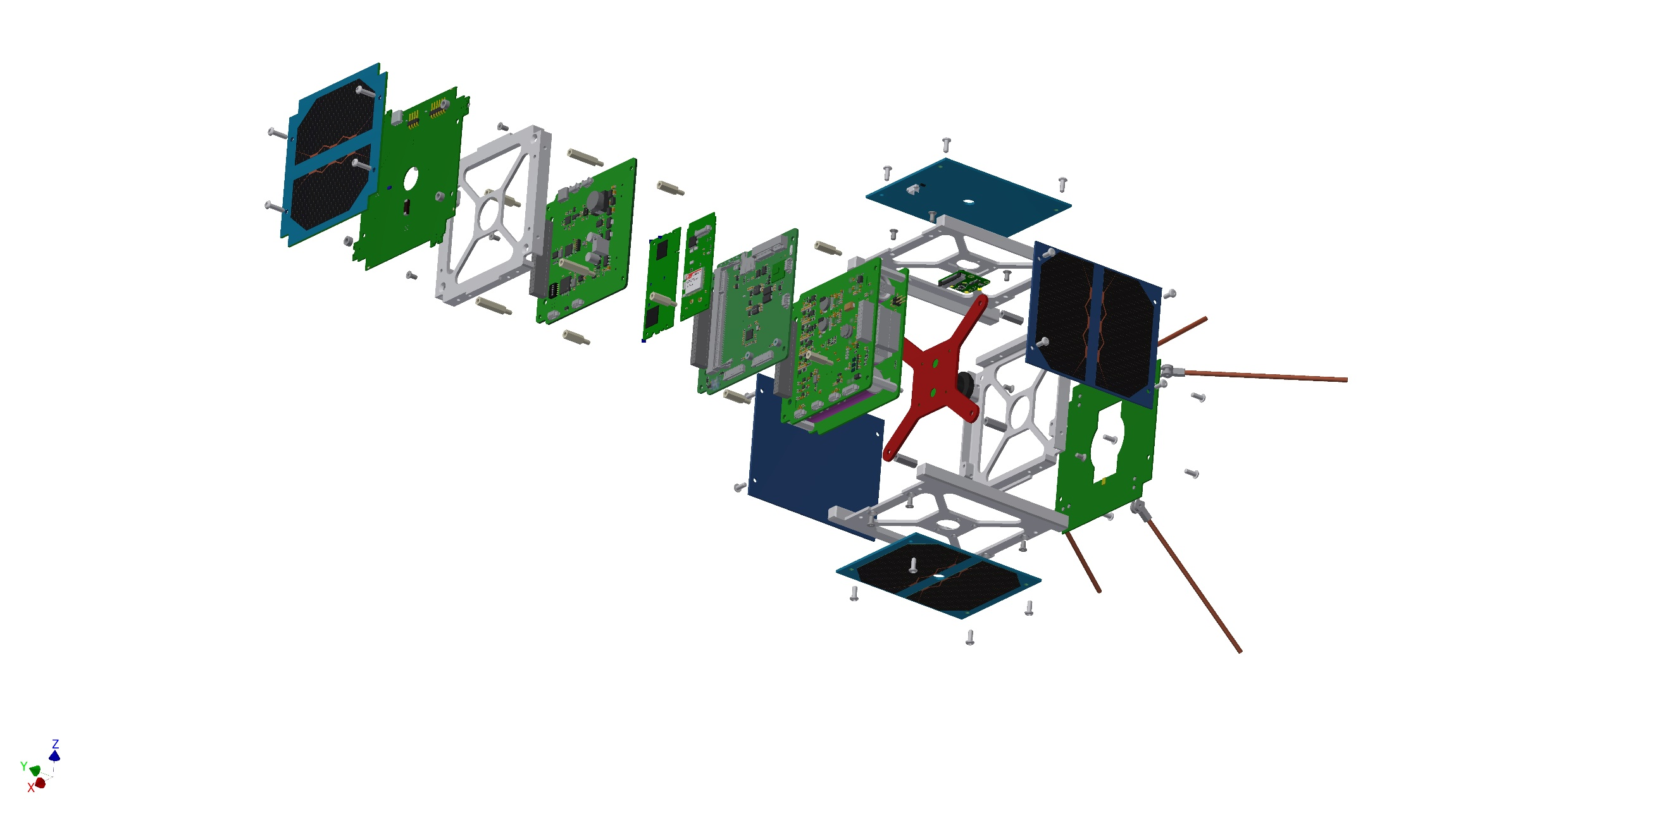
1. A spacecraft is a collection of different subsystems
OBC
Subsystems of UniSat 1U Nano-Satellite
kaznu.kz
sciencepark.kz
Notes:
A satellite or spacecraft is made up of many different sub-systems that all need to work together as an integrated system. Avionic architectures have a key role in making this possible, linking together modules and equipment from different subsystems and with varying functionality so that the entire spacecraft can be managed and operated effectively.

Slide 5
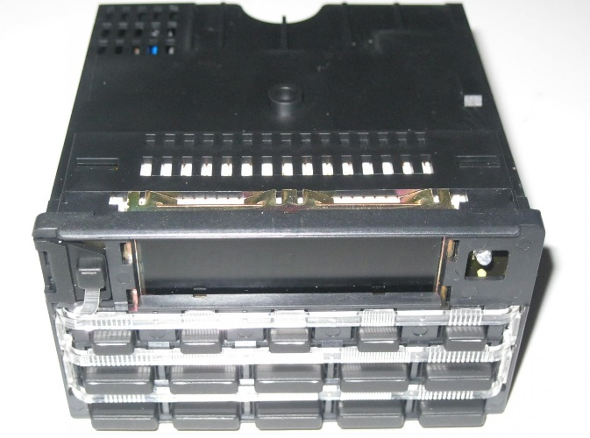
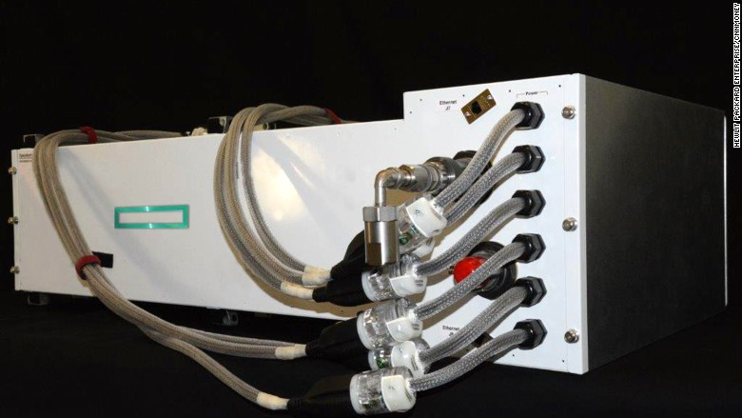
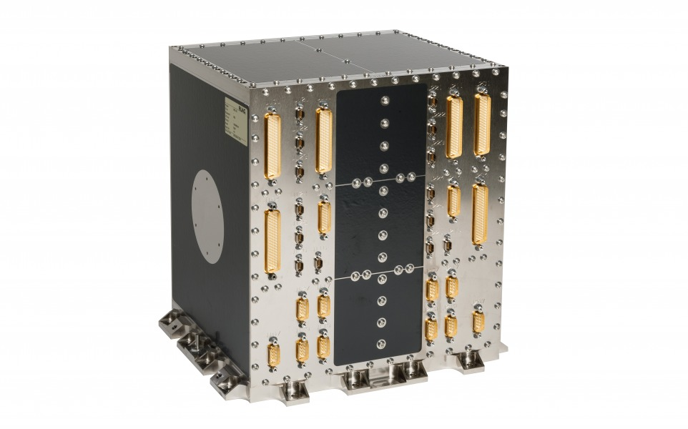
2. On-Board Computer (OBC) is the brain of the spacecraft
© Pantri Trading
BMW On board Computers for Spacecraft
© RUAG Space​
© CNN
Commercial OBC from RUAG Space
SpaceX’s On-board Computer on Falcon 9
kaznu.kz
sciencepark.kz
Notes:
One of the core components of the avionics system is the on-board computer (OBC) – the piece
of hardware that runs the craft’s on-board software which controls the vital functions the system needs, in order to perform effectively.
On a general spacecraft or satellite, the OBC plays several important roles during the flight mission. These functions usually include:
Attitude and orbit control,
Telemetry data management,
Telecommunication actions,
System housekeeping,
On-board time synchronisation, and
Failure detection, isolation and recovery.

Slide 6
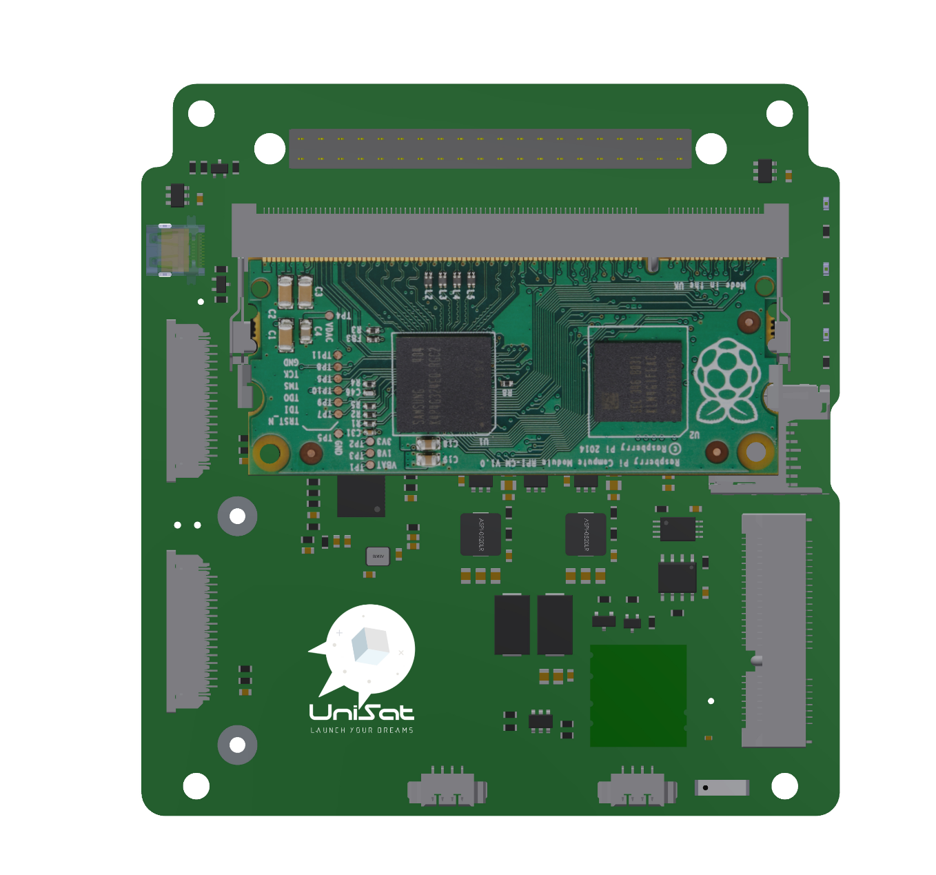
OBC functions of UniSat
Coordination of actions
Sending orders
Data processing and storage
Satellite imaging
Raspberry Pi
kaznu.kz
sciencepark.kz
Notes:
The On Board Computer, or OBC, is the brain of the UniSat and has different missions such as the coordination of all the actions, sending orders to the different modules or subsystems, the reception and storage of telemetry data and other information of the CubeSat, sending this information back to Earth via the TRX subsystem, taking satellite images or videos, and also error handling within the CubeSat.

Slide 7
OBC Subsystem division
Microprocessor
Interfaces
Cameras
Processing Sensor Data
Coordination
Data Storage
Data Distribution
Image
Video
Raspberry Pi
kaznu.kz
sciencepark.kz
Notes:
The OBC is divided into three subsystems which are Microprocessor, Interfaces and Cameras.
The Microprocessor or the raspberry Pi Compute Module 3, is a processing unit of the OBC dedicated to the Satellite Management (SM). Its has to manage the data from other modules collected through the interface and process it and save to the data storage, on UniSat, it is the SD card.
The CM3 also in charge of the storing system data, operation data, logs and debugging information.
The interface subsystem is responsible for the communication with other modules. It ensures a good connection with other systems of the satellite and allows them to send information. It is also in charge of collecting the power supplied by the EPS.
The camera modules on the OBC, are primarily used for recording during flight videos and images.

Slide 8
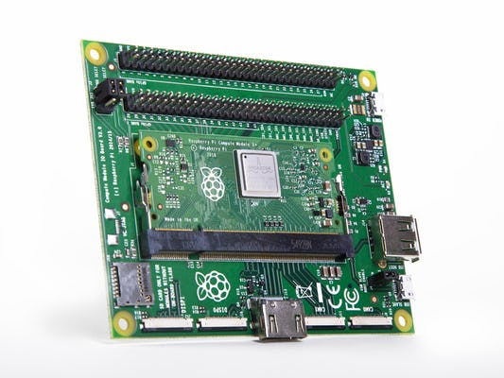
3. Raspberry Pi Compute Module 3
BCM2837 (Cortex-A53) Chipset
64 Bit SOC
1.2 Ghz Clock Speed
1GB LPDDR2 SDRAM
Temperature range: -25 – 85 C
CM3 and CM3IO Board
Credit: Raspberry Pi Foundation
kaznu.kz
sciencepark.kz
Notes:
To select the best microcontroller or microprocessor for the OBC, we have to take care about many things such as power consumption, temperature, operating voltage, I/O and serial bus compatibility to avoid some issues.
The compute module 3 from the Raspberry Pi foundation, is a complex yet powerful device, including Broadcom BCM2837 Cortex-A53 64-bit SoC at 1.2Ghz clock speed. CM3 also build in a 1GB of LPDDR2 SDRAM.
Also the CM3 is designed for industrial applications so that it can work on extreme temperature environment from -25 to 85 C.

Slide 9
4. CM3 as the UniSat OBC
Compatibility
Adequate Computing Power
Fast Clock Speed
Flexible Integration
Low Power Consumption
Support from the RPi Team
Open Source Community
CM3 and CM3IO Board
Credit: Raspberry Pi Foundation
CM3 on the UniSat
Image credit: Raspberry Pi Foundation
kaznu.kz
sciencepark.kz
Notes:
We selected raspberry pi compute module 3 as a computing power for the UniSat nano-satellites, because of it’s compatibility with other microcontrollers, adequate computing power for signal processing, fast enough clock speed for speed sensitive communication, flexibility of hardware integration, low power consumption, first class technical support and solutions from the Raspberry Pi Foundation and the Open Source Community.

Slide 10
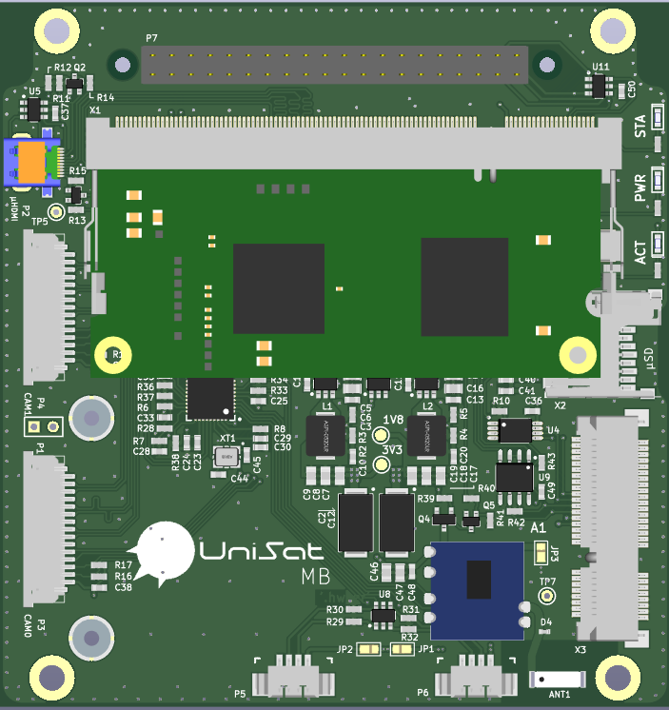
5. Interfaces on the UniSat OBC
UART (RS485)
Notice: visit https://unepg.github.com/unisat/obc.html for interactive 3D view
kaznu.kz
sciencepark.kz
Notes:
OBC on the UniSat includes several industry standard hardware interfaces for data and commands transmissions.
UART or the RS485 lines on the OBC are connected to all other subsystems of the satellite through the 40 pin connector, It’s used as the main media for communication on the satellite.
I2C bus from the OBC connects to other sensor modules on the sensor-board, used for managing sensors and receiving telemetry data.
Two raspberry Pi camera modules connected to the OBC using CSI camera interfaces.
OBC also includes SD card interface connecting external storage devices.
You can also use the USB and HDMI interfaces on the OBC, then it operates as a general PC.

Slide 11
5. Interfaces on the UniSat OBC
UART (RS485)
I2C
Notice: visit https://unepg.github.com/unisat/obc.html for interactive 3D view
kaznu.kz
sciencepark.kz
Notes:
OBC on the UniSat includes several industry standard hardware interfaces for data and commands transmissions.
UART or the RS485 lines on the OBC are connected to all other subsystems of the satellite through the 40 pin connector, It’s used as the main media for communication on the satellite.
I2C bus from the OBC connects to other sensor modules on the sensor-board, used for managing sensors and receiving telemetry data.
Two raspberry Pi camera modules connected to the OBC using CSI camera interfaces.
OBC also includes SD card interface connecting external storage devices.
You can also use the USB and HDMI interfaces on the OBC, then it operates as a general PC.

Slide 12
5. Interfaces on the UniSat OBC
UART (RS485)
I2C
CSI Camera
Notice: visit https://unepg.github.com/unisat/obc.html for interactive 3D view
kaznu.kz
sciencepark.kz
Notes:
OBC on the UniSat includes several industry standard hardware interfaces for data and commands transmissions.
UART or the RS485 lines on the OBC are connected to all other subsystems of the satellite through the 40 pin connector, It’s used as the main media for communication on the satellite.
I2C bus from the OBC connects to other sensor modules on the sensor-board, used for managing sensors and receiving telemetry data.
Two raspberry Pi camera modules connected to the OBC using CSI camera interfaces.
OBC also includes SD card interface connecting external storage devices.
You can also use the USB and HDMI interfaces on the OBC, then it operates as a general PC.

Slide 13
5. Interfaces on the UniSat OBC
UART (RS485)
I2C
CSI Camera
SD Interface
Notice: visit https://unepg.github.com/unisat/obc.html for interactive 3D view
kaznu.kz
sciencepark.kz
Notes:
OBC on the UniSat includes several industry standard hardware interfaces for data and commands transmissions.
UART or the RS485 lines on the OBC are connected to all other subsystems of the satellite through the 40 pin connector, It’s used as the main media for communication on the satellite.
I2C bus from the OBC connects to other sensor modules on the sensor-board, used for managing sensors and receiving telemetry data.
Two raspberry Pi camera modules connected to the OBC using CSI camera interfaces.
OBC also includes SD card interface connecting external storage devices.
You can also use the USB and HDMI interfaces on the OBC, then it operates as a general PC.

Slide 14
5. Interfaces on the UniSat OBC
UART (RS485)
I2C
CSI Camera
SD Interface
HDMI
Notice: visit https://unepg.github.com/unisat/obc.html for interactive 3D view
kaznu.kz
sciencepark.kz
Notes:
OBC on the UniSat includes several industry standard hardware interfaces for data and commands transmissions.
UART or the RS485 lines on the OBC are connected to all other subsystems of the satellite through the 40 pin connector, It’s used as the main media for communication on the satellite.
I2C bus from the OBC connects to other sensor modules on the sensor-board, used for managing sensors and receiving telemetry data.
Two raspberry Pi camera modules connected to the OBC using CSI camera interfaces.
OBC also includes SD card interface connecting external storage devices.
You can also use the USB and HDMI interfaces on the OBC, then it operates as a general PC.

Slide 15
5. Interfaces on the UniSat OBC
UART (RS485)
I2C
CSI Camera
SD Interface
HDMI
USB
Notice: visit https://unepg.github.com/unisat/obc.html for interactive 3D view
kaznu.kz
sciencepark.kz
Notes:
OBC on the UniSat includes several industry standard hardware interfaces for data and commands transmissions.
UART or the RS485 lines on the OBC are connected to all other subsystems of the satellite through the 40 pin connector, It’s used as the main media for communication on the satellite.
I2C bus from the OBC connects to other sensor modules on the sensor-board, used for managing sensors and receiving telemetry data.
Two raspberry Pi camera modules connected to the OBC using CSI camera interfaces.
OBC also includes SD card interface connecting external storage devices.
You can also use the USB and HDMI interfaces on the OBC, then it operates as a general PC.

Slide 16
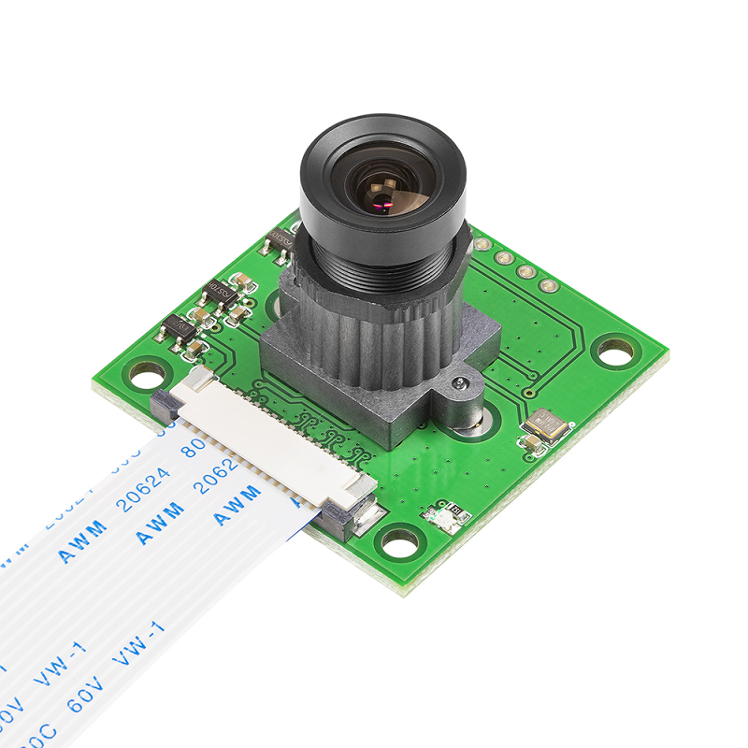
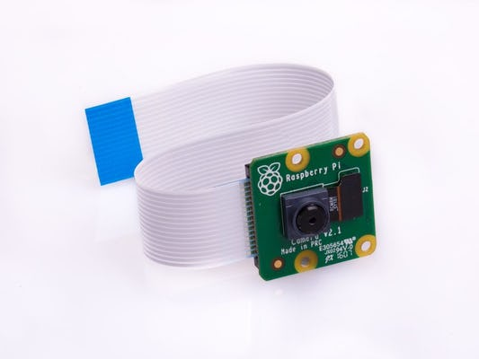
6. Cameras on the OBC
Raspberry Pi Camera Module V2 (image: Raspberry Pi Foundation)
Raspberry Pi Fisheye Camera (image: Waveshare)
kaznu.kz
sciencepark.kz
Notes:
As we have introduced earlier, OBC on the UniSat controls two CSI cameras to take continues images and videos during it’s flight mission.
Due to the insufficient packet size in LoRa communication between ground station and the spacecraft, images and videos taken by the cameras, first processed on the OBC and then saved to the internal SD card.

Slide 17

7. Review
Introduction
PCB Design
Software Development
You are here!
kaznu.kz
sciencepark.kz
Notes:
In this lesson we have introduced the OBC of a spacecraft, it’s hardware architecture, functions and its components. In the next lesson, we are going to learn how to plan and design an OBC using one of the most popular PCB prototyping and designing tools. See you on the next lesson, I wish you enjoy your study and have a nice day!

Slide 18
The following materials are used in this lecture.
Literature:
1. "A Study of Common OBC HW Architecture for LEO & GEO Satellite", JC-SAT 2009, Yun Ki Lee, Joo Ho Won, Sang Kon Lee.
2. "Current Satellite OBC Development Status", Avionics Systems Symposium, Korea 2011, Young Ho Cho.
3. H. E. H. Ahmed, E. Kamal and A. Elsayed, "Telemetry microcomputer application in satellites OBC," 2009 First Asian Himalayas International Conference on Internet, 2009, pp. 1-6, doi: 10.1109/AHICI.2009.5340347.
4. M. Fayyaz and T. Vladimirova, "Fault-Tolerant Distributed approach to satellite On-Board Computer design," 2014 IEEE Aerospace Conference, 2014, pp. 1-12
Internet resources:
https://unepg.github.io/unisat/obc.html
https://www.waveshare.com/product/raspberry-pi/cameras/rpi-camera-b.htm
https://www.raspberrypi.com/products/camera-module-v2/
https://www.raspberrypi.com/products/compute-module-3-plus/
https://www.raspberrypi.com/products/compute-module-io-board-v3/
https://blog.satsearch.co/2020-03-11-an-overview-of-on-board-computer-obc-systems-available-on-the-global-space-marketplace
https://www.esa.int/Enabling_Support/Space_Engineering_Technology/Onboard_Computers_and_Data_Handling/Onboard_Computers
https://aerospace.honeywell.com/us/en/learn/products/space/spacecraft-on-board-computer
https://www.zdnet.com/article/spacex-weve-launched-32000-linux-computers-into-space-for-starlink-internet/
https://money.cnn.com/2017/08/12/technology/future/spacex-nasa-supercomputer/index.html
https://www.pantritrading.com/bmw-e32-e34-bc5-obc-on-board-computer-display-8351055-65818351055.html?currency=KZT&gclid=CjwKCAiAsNKQBhAPEiwAB-I5zZMm7UAxcSLSMO3xpBOQL2hS6di-NzN5STwrTW6oI4OkqkT_W7CxSRoCD0QQAvD_BwE
https://www.ruag.com/system/files/media_document/2020-11/OBC-NG%20November%202020_0.pdf
kaznu.kz
sciencepark.kz

